Slide 1
FPGA Workshop
Dock18 – 7 & 8 October 2017

Slide 2
FPGA? PROM vs PAL vs FPGA
Programable Read-Only Memory (PROM) and Programable Array Logic (PAL)
One time programable, burning fuses
Combination of an AND Array and an OR Array
PROM vs PAL
AND Array fix vs OR Array Fix

Slide 3
FPGA? PROM vs PAL vs FPGA
Field Programable Gate Array
SRAM based, needs programing after power cycle
Combination of a Logic Cell Array and Connection Matrix
Logic Cell (simplified)
4 Input, 1 Output, CLK, RST, LUT, FF, MUX,
Programable LUT and MUX

Slide 4
FPGA? PROM vs PAL vs FPGA
Switching Matrix (simplified)
N-Input, N-Output, 1 to N connection
Programable Transistor Array

Slide 5
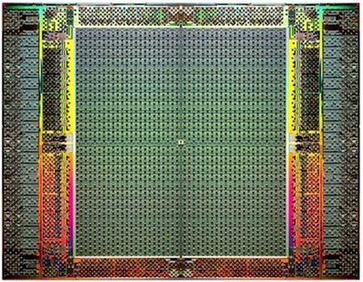
FPGA? PROM vs PAL vs FPGA
Combination of both
Logic Cells connected to Switching Matrix and then to Logic Cells again …

Slide 6
FPGA? PROM vs PAL vs FPGA
With these two building blocks basically all digital designs can be built
Same FPGA can be used for many purposes
PWM Generator
I2C Controller
Serial Transceiver
Softcore CPU
Digital Filter
Coprocessors (Encryption, Calculations etc.)
Etc.

Slide 7
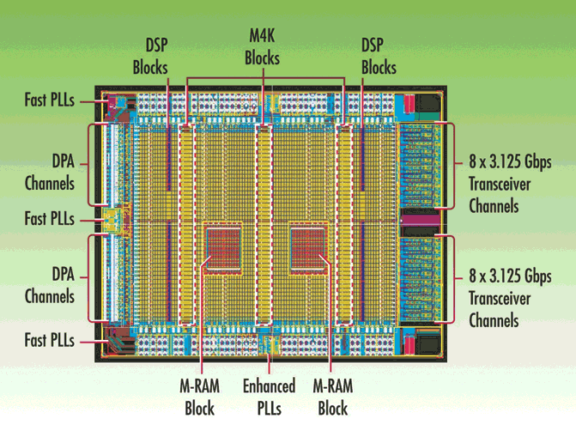
FPGA? PROM vs PAL vs FPGA
Todays FPGAs have between a couple of 1000 and a couple of 100000 Logic Cells
DE0 Nano 22320 Logic Cells
But today FPGAs contain much more than just Logic Cells and Switching Matrixes
Block RAM
DSP Slices
Multiplier and Adder
PLLs
Gigabit Transceivers
Clock Networks
Etc.

Slide 8
FPGA? PROM vs PAL vs FPGA
FPGA has to be loaded after Powercycle
Config Flash which stores the configuration for the FPGA which is fetched by the FPGA at boot time
Pushing configuration via JTAG

Slide 9
FPGA? MCU vs FPGA
MCU processes instruction sequencialy
Program is a list of instructions and data
CPU processes one instruction after the other
FPGAs process «instructions» in parallel
«Program» is a describtion of the hardware
All Logic Cells and Switching Matrixes are active at the same time
Sequencializing of tasks with statemachines or pipelines

Slide 10
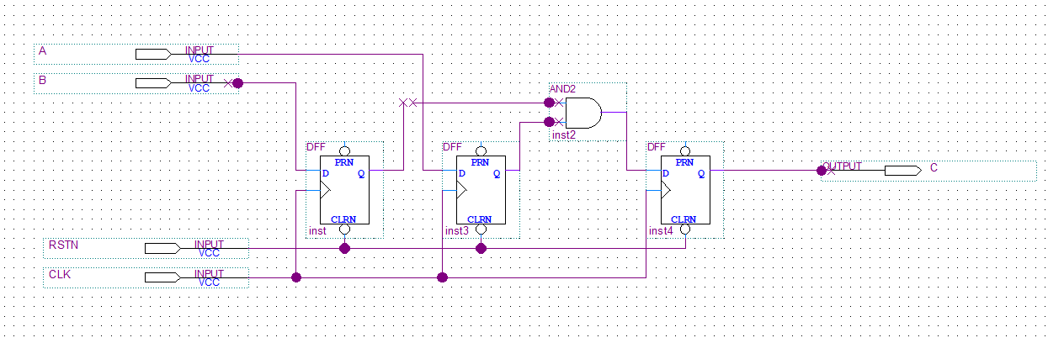
FPGA? How do I program that thing?
Old and very inefficient:
Instantion of building blocks and connecting them
Either graphical or in a programing language

Slide 11
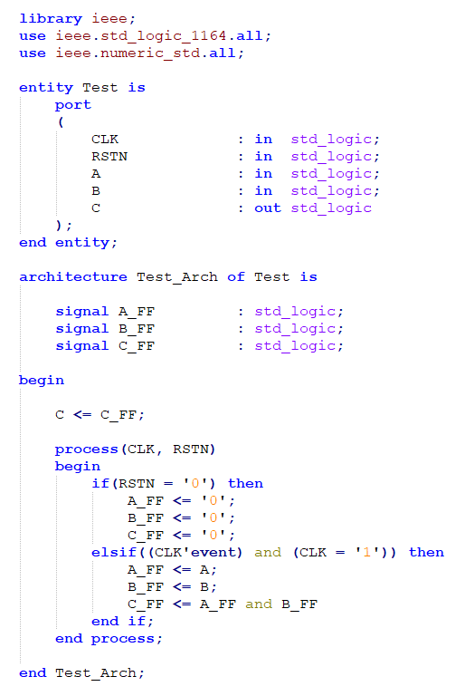
FPGA? How do I program that thing?
Modern, and how we are doing it:
With a Hardware Description Language: VHDL

Slide 12
VHDL? What is this?
Very High Speed Integrated Circuit Hardware Description Language (VHDL)
Syntax based on ADA
Very very type strict!
Describe the desired behaviour and let the FPGA tool figure out what building blocks it needs and how to connect them
Abstracts the internals from the functionality

Slide 13
Developing an FPGA Design? How does it work?
Couple of different inputs needed:
VHDL Design
Defines what the FPGA shall do
Pinout Constraints
Defines which Input and Output pins shall be used by the VHDL Design
Timing Constraints
Defines the timely behaviour of external interfaces and defines timing maxima internaly

Slide 14
Developing an FPGA Design? How does it work?
Analyser & Synthesiser:
Analyses the source code and converts VHDL code into building blocks
Output can be again a VHDL file which only contains instatiation of FPGA primitives
Fitter (Place and Router)
Places the FPGA primitives into individual Cells
Interconnects the Cells via the Switching Matrix
Takes the Pinout and Timing Constraints into account, where bestto place Logic and how to interconnect them

Slide 15
Developing an FPGA Design? How does it work?
Assembler:
Converts the configuration of each Logic Cell and Switching Matrix in one so called Bitstream which is in the end the Programming File which is loaded into the FPGAs SRAM which is defining the functionality.
Programmer:
Allows to configure the Bitstream via USB to JTAG into the FPGA
Timing Analyser:
Checks if the internal and external timing is fullfiled

Slide 16
Developing an FPGA Design? How does it work?
Simulator:
Simulates in software the behaviour based on the source code to verify the functionality
Needs a so called Testbench which instantiates the design an stimulates the inputs and checks the outputs

Slide 17
Developing an FPGA Design? How does it work?
Most steps provides input for the next step
There are more tools which make FPGA development and debugging easier

Slide 18

VHDL Basics What is all that code?
Things happen in parallel but result in one clock cycle is only available in the next cycle!

Slide 19
VHDL Basics What is all that code?
VHDL has statements which can be used for simulation only
File operations
Others like: wait for 100 ms
Etc.

Slide 20
Let’s get our hands dirty!
Enough theory, let’s get our hands dirty with our first project!

Slide 21
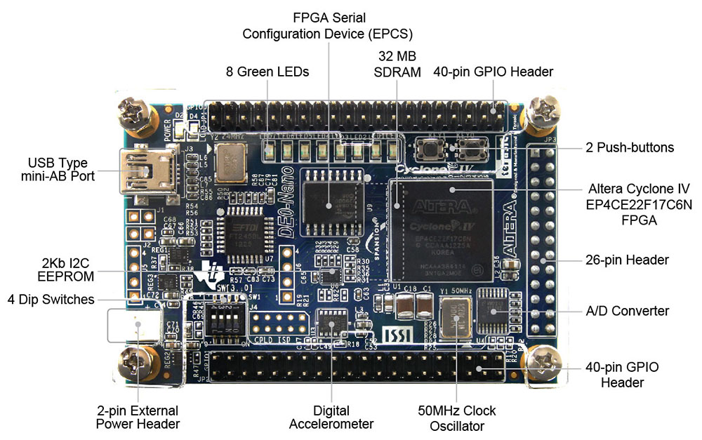
DE0 Nano Board

Slide 22
Project constraints
Some points to simplify things:
Keep the names of the entities the same as I
Keep the names of the inputs and outputs the same as I
Use the same protocol for our Transceiver
If you have a question ask imediately, it might be interesting to others as well and keeps you from loosing track and time
After the first project copy that folder an rename it, you don’t want to start the whole project wizard again from scratch

Slide 23
Project Button and LED
We create a first FPGA design and see how the design flow is and how we can put some stupid logic in the FPGA, clocked and combinatorical
What we will do:
Create a first Quartus Project
Create a first VHDL File
Create Pinout Constraints
Create Timing Constraints
Make a first design run and configure the FPGA
Advance the Design
See a testbench example

Slide 24
Project LED PWM
We create a Pulse Width Modulator to have different brightness on LEDs and we create a Knightrider pattern on the LEDs
What we will do:
Create a PWM generator
Create a Knightrider pattern generator
See another testbench

Slide 25
Project Transceiver
We create a transceiver which transfers its own LED pattern to another ones DE0 Nano via a serial interface and display the received LED pattern.
What we will do:
Create a Transmitter
Create a Receiver
See another testbench
Put all together

Slide 26
Project Accelerometer (maybe)
Make use of the accelerometer on the DE0 Nano to create a spirit level (Wasserwaage).
What we will do:
We integrate the I2C acceloremeter and LED geneator and try to understand what’s going on

